Slide 1
Technical Skill Assessment For Inclusivity Institute for Better Data
Aiswarya Ravindran
Jan 2024

Slide 2
Contents
Executive Summary
The Basis of this analysis ( what are we trying to find out)
The data set provided
The Data analysis Process ( clean/transform/model/visualization)
The ETL Process
Visualization
Findings -What the data indicates
Recommendations (based on data and the questions asked)

Slide 3
Executive Summary
The essence of the data analysis
Datasets provided
Your methodology
Your findings

Slide 4

The Basis of this analysis ( what are we trying to find out)
The analysis of the IIDB dataset about a minority community, using variables such as Age, Income, Gender, Employment status, Educational level, Perceived barriers to education and employment, has raised certain questions about the income inequality amongst gender with same academic qualification.
Analyzing these dataset will also create awareness on gender and age inequality to employment. Also, analyzes the effect of the level of education on employment using the dataset.

Slide 5
The data set provided
ID | Age | Gender | Education_Level | Employment_Status | Income | Perceived_Barriers_to_Education | Perceived_Barriers_to_Employment
1 | 42 | Non-Binary | None | Student | 0 | Accessibility | None
2 | 44 | Female | Master's | Student | 20000 | Financial | None
3 | 20 | Female | None | Student | 100000 | Accessibility | Lack of Opportunities
4 | 34 | Male | None | Student | 20000 | Accessibility | None
5 | 50 | Male | Master's | Unemployed | 0 | Financial | Discrimination
6 | 49 | Non-Binary | High School | Employed | 60000 | Financial | None
7 | 43 | Male | Bachelor's | Employed | 0 | None | None
8 | 37 | Male | Bachelor's | Unemployed | 0 | Accessibility | None
9 | 48 | Male | Master's | Employed | 60000 | Accessibility | Lack of Opportunities
10 | 40 | Male | High School | Employed | 80000 | None | Discrimination
11 | 55 | Non-Binary | High School | Employed | 80000 | Accessibility | Lack of Opportunities
12 | 31 | Non-Binary | None | Employed | 40000 | None | Lack of Opportunities
13 | 50 | Non-Binary | High School | Student | 60000 | None | None
14 | 26 | Female | High School | Unemployed | 60000 | Financial | None
15 | 36 | Non-Binary | Bachelor's | Student | 80000 | None | Discrimination
16 | 26 | Non-Binary | Bachelor's | Unemployed | 100000 | Financial | None

Slide 6
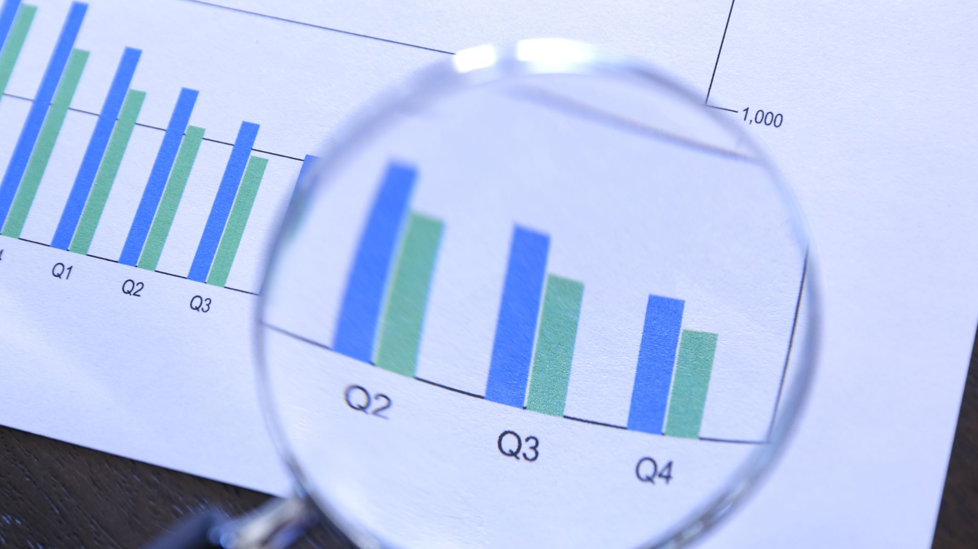
The ETL process
The dataset was relatively clean, with the exceptions of certain anomalies.
The dataset includes zero income for employed individuals; finding the average/mean of each employed education category, I arrived at an approximate value of $60,000.
Also, certain unemployed individuals were making the maximum amount possible, but because it is a small dataset, we included them in our analysis.

Slide 7
The ETL Process
The modeling was done utilizing both MS Excel (Pivot table) and Power BI.
The relationship diagram was derived using Power BI by merging queries.

Slide 8
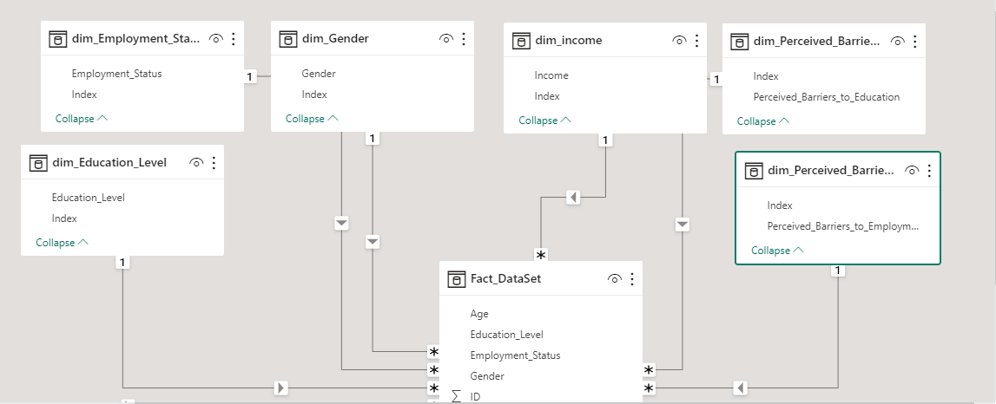
Relationship Diagram

Slide 9
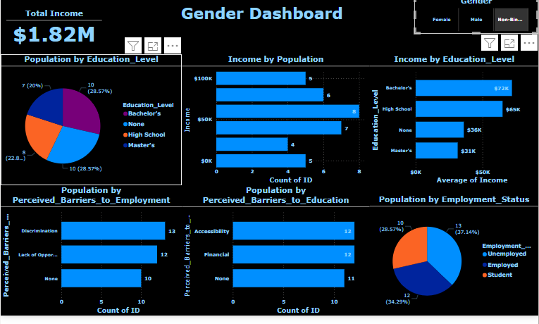
Visualization

Slide 10
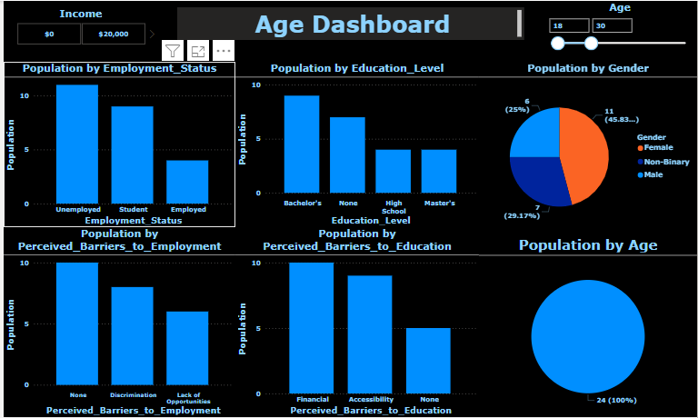
Visualization

Slide 11
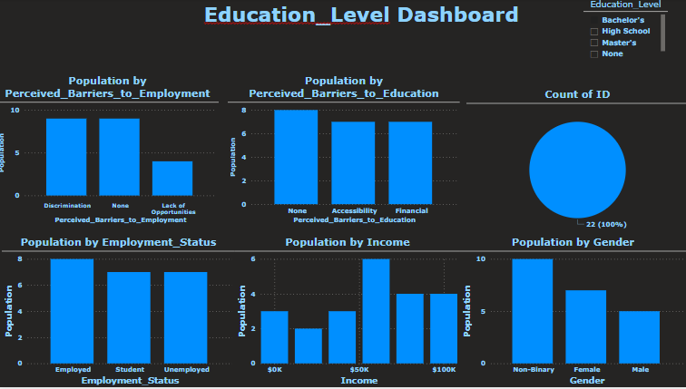
Visualization

Slide 12
Part 1: Findings - What the data indicates
Dividing the population to different age bands,
46% of individuals between the ages of 18-30 are unemployed
42% of individuals between the ages of 31-40 are unemployed,
44% of individuals 41-50 years are unemployed,
while only 25% of people between the ages of 51 – 64 are unemployed.
47% of people between the ages of 51 – 64 are gainfully employed while only 17% of people in ages 18-30 are employed.
71% of people between the ages of 18 – 30 are educated (high school to masters) while 69% of peoples between the ages of 51 – 64 are educated.

Slide 13
Part 1: Findings - What the data indicates
Dividing the population to different age bands,
71% of people between the ages of 18 – 30 are educated (high school to masters) while 69% of peoples between the ages of 51 – 64 are educated.
30% of the individuals between the ages of 18 – 30 perceive they are being discriminated against.
This indicates a huge disparity in the community’s workforce.
They may not be as experienced but are equally as educated.

Slide 14
Part 2: Findings - What the data indicates
According to the dataset, there is a huge disparity in employment rates by gender;
72% of the female population have graduated high school, Bsc or Msc, while 71% and 72% of the male and non-binary population graduated high school and above.
Only 25% of the female population is employed compared to 34% of the male and non-binary population that are gainfully employed.
In the age band 18-30 with the lowest employment rate, 46% of them are female.
It is noteworthy that employment rate is really low in this community with only 32% of the entire population employed.

Slide 15
Part 2: Findings - What the data indicates
The data also depicts that 39% of the population believe they’re discriminated against when looking for employment, while 30% perceive their unemployment as lack of opportunity.
Furthermore, 36% of the population perceive inaccessibility as the reason why they weren’t educated, while 32% agree it is financial reasons.
Data showing the courses studied [are they STEM courses or humanities] by the female gender and their marital status could assist in further analysis of this dataset.
Moreover, the type of businesses in the community in question, (for instance is the community close to crude oil exploration site, where certain types of skillsets are needed?) much consideration should be given to skillset needed by businesses in the community in question.

Slide 16
Part 2c: Ethical Considerations
Primary considerations encompass matters concerning privacy, confidentiality, consent for sensitive information, the risk of potential harm, cultural sensitivity and benefits to the community.
Privacy and confidentiality emerge as crucial aspects during data collection and utilization for research, recognizing that individuals may be hesitant to have specific personal information disclosed or publicized.
Privacy and confidentiality can be achieved by anonymizing data, obtaining informed consent from participants and adhering to data protection regulation.
Findings from data collected should be used responsibly minimizing potential harm that could result from data analysis.
Considerations should be given to unique values, beliefs and practices of marginalized communities, data analysis should be approached with cultural sensitivity.

